Slide 1



Introduction to Git
The storyline of your files

Slide 2
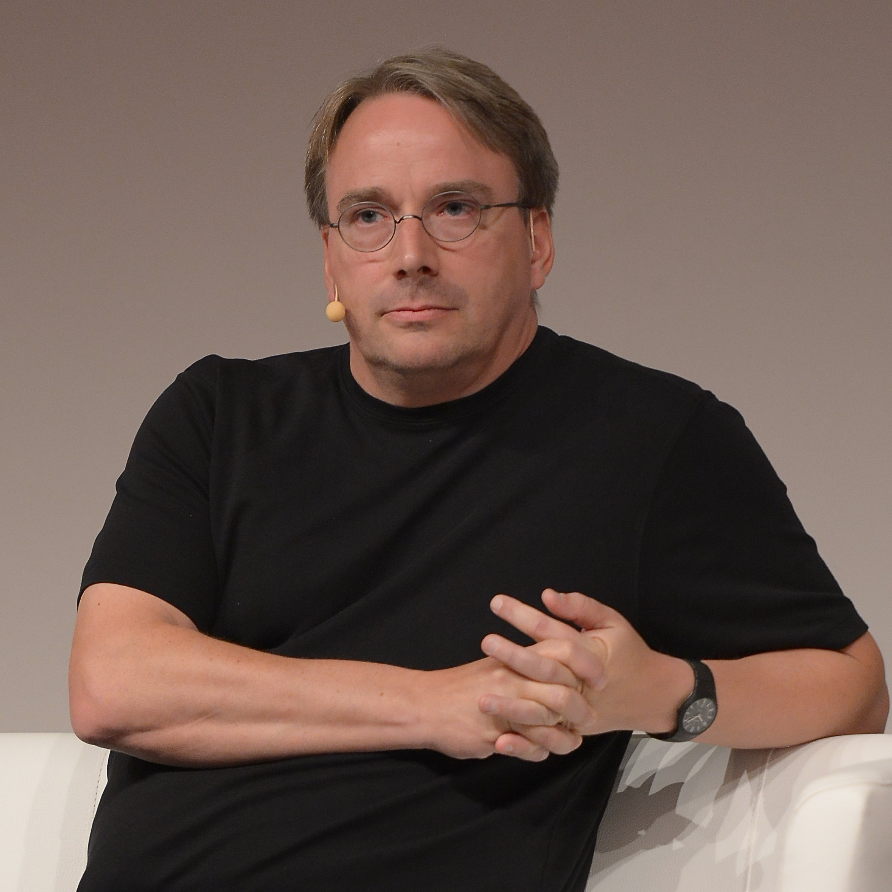


What is Git
Git is a version control system (VCS)
2005 by Linus Torvalds
Distributed paradigm
Full fledged. Collaboration oriented
Predecessors:
CVS, Subversion

Slide 3
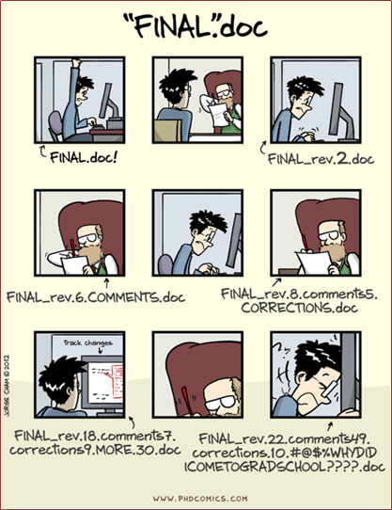
Why I need VCS (Git)
VCS tracks changes on your files
Using commits
Repositories & Changes:
Remote ← Local ← Index ← Workspace
Use Gitflow workflow
All in branches: features, release, hotfix All branches at one point die or merged

Slide 4
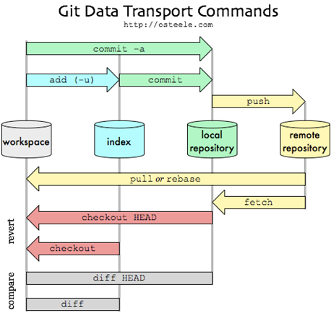
How it works
Repository:
Is your workspace where your files lives
Commit:
Snapshot of your changes
Branch:
A group of simple changes with a goal
History:
A group of ordered commits
Merge:
Fuse changes
Fork:
Creates a [hard] copy of the repository

Slide 5


Slide 6

Create repository
It’s not a git folder
> git init [folder]
> git add [folder]
> git commit -m “my first commit”
> git remote add xxx
It exists remotely
> git clone xxxx
It’s already a git folder
> git remote add xxx

Slide 7

Basic Snapshotting (commit)
> git add
> git status
> git diff
> git commit
> git reset
> git rm
> git mv

Slide 8
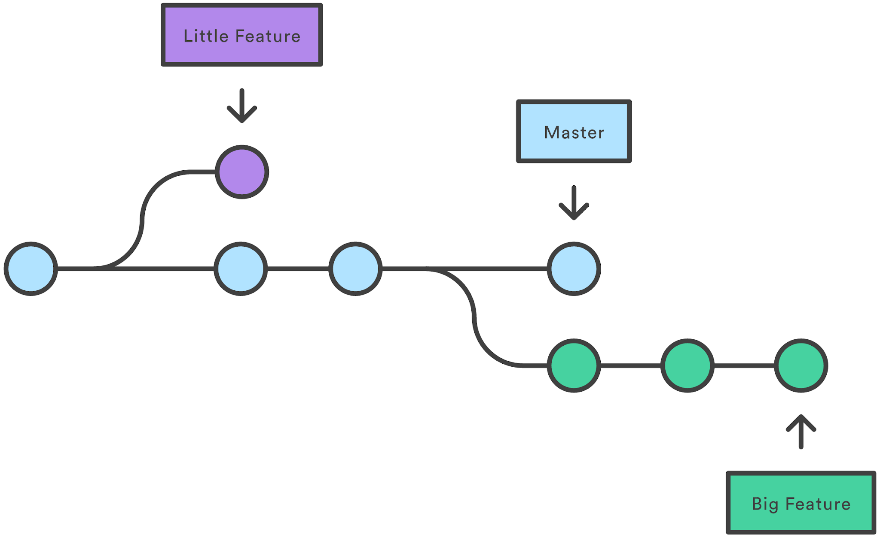
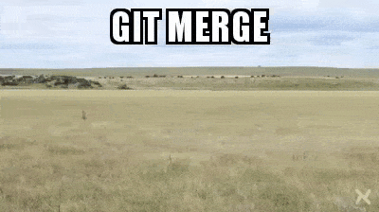
Branching & Merging
> branch
> checkout
> merge
> log
> stash

Slide 9
Share & Updating projects
> git fetch
> git pull
> git push
> git remote
> git rebase

Slide 10
Git tools
> log
> interactive indexing(staging)
> stash
> rewrite history
> debugging: Blaming and bisecting
> submodules
> subtree merging

Slide 11
Reference
Git documentation:
https://git-scm.com/docs
Interactive cheat sheet:
http://ndpsoftware.com/git-cheatsheet.html

Slide 12

Thanks

